Slide 1
Introduction to Rotary

Slide 2
ROTARY
An international organisation:
  1.4m members
  46,000 clubs
  The majority of countries have a Rotary presence.
  Rotary members believe that we have a shared responsibility to take action on our world’s most persistent issues
Our mission
  We provide service to others, promote integrity, and advance world understanding, goodwill, and peace through our fellowship of business, professional, and community leaders.
Vision statement
  Together, we see a world where people unite and take action to create lasting change — across the globe, in our communities, and in ourselves.

Slide 3
ROTARY
The OBJECT of ROTARY:
  The Object of Rotary is to encourage and foster the ideal of service as a basis of worthy enterprise and, in particular, to encourage and foster:
    FIRST: The development of acquaintance as an opportunity for service;
    SECOND: High ethical standards in business and professions; the recognition of the worthiness of all useful occupations; and the dignifying of each Rotarian’s occupation as an opportunity to serve society;
    THIRD: The application of the ideal of service in each Rotarian’s personal, business, and community life;
    FOURTH: The advancement of international understanding, goodwill, and peace through a world fellowship of business and professional persons united in the ideal of service.

Slide 4
ROTARY
The Four-Way Test
  The Four-Way Test is a nonpartisan and non-sectarian ethical guide for Rotarians to use for their personal and professional relationships. The test has been translated into more than 100 languages, and sometimes Rotarians recite it at club meetings:
Of the things we think, say or do
  Is it the TRUTH?
  Is it FAIR to all concerned?
  Will it build GOODWILL and BETTER FRIENDSHIPS?
  Will it be BENEFICIAL to all concerned?

Slide 5
ROTARY – 7 areas of focus
Peacebuilding and conflict prevention
  Rotary encourages conversations to foster understanding and trains leaders to prevent and mediate conflict.
Disease prevention and treatment
  Rotary educates communities and improves access to health care to stop the spread of diseases like polio, HIV/AIDS, and malaria.
Water, sanitation, and hygiene
  Rotary supports local solutions to provide clean water, sanitation, and hygiene to more people.
Maternal and child health
  Rotary focuses on saving mothers and children from malnutrition, poor health care, and inadequate sanitation.
Basic education and literacy
  Rotary supports education to help end illiteracy.
Community economic development
  Rotary supports investments in people and communities to alleviate poverty and create economic improvements.
Environment
  Rotary members tackle environmental issues by coming up with projects, using their connections to change policy, and planning for the future.

Slide 6
Benefits of being a Rotarian (1)
1. Giving back / service opportunities
Rotarians have many opportunities for service projects, both locally and internationally. Service programs address such concerns as health care, hunger, poverty, illiteracy, and the environment. Rotarians experience the enjoyment and pride that comes from giving back to the community. There are countless opportunities to make a difference to those less fortunate than ourselves. If you like helping others, here is your chance to do something worthwhile and make a real difference. Being a Rotarian is richly rewarding and Rotarians help each other and collectively help others.
2. Friendship
In an increasingly complex world, Rotary provides one of the most basic human needs; the need for friendship. Rotary was founded on fellowship, an ideal that remains a major attraction of membership today. Club members enjoy the camaraderie with like-minded people, and club projects offer additional opportunities to develop enduring friendships. Rotary club members who travel have friendly contacts in almost every city in the world. Make friends in your own community and further afield.
3. Personal growth and development
Membership of Rotary develops leadership, public speaking, social, business, personal and vocational skills as well as improving cultural awareness and broad social skills. Rotary takes ordinary individuals and puts them into extraordinary circumstance. Simply stated, membership in Rotary helps to make our members better – better individuals, community leaders, internationalists, and humanitarians.
4. International Connections
One of Rotary’s highest objectives is to build goodwill and peace throughout the world. With over 35,000 clubs in over 200 countries, wherever you travel, for pleasure or on business, you can contact local Rotarians for friendship or assistance. Every Rotarian is welcome - even encouraged - to attend any of the clubs around the world and you have instant friends in the world community. Because there are Rotary clubs everywhere, many a Rotarian in need of a doctor, lawyer, hotel, dentist, advice, etc., while traveling has found assistance through Rotary. Visiting a Rotary club while you are traveling will give you immediate access to local resources and information.

Slide 7
Benefits of being a Rotarian (2)
5. Cultural awareness
Around the world, practically every religion, country, culture, race, creed, political persuasion, language, colour and ethnic identity is found in Rotary. It is a cross section of the world's citizens from every background. Rotarians become aware of their cultures and learn to love and work with people everywhere.
6. Youth and Family
Rotary sponsors one of the world’s largest youth exchange, educational exchange, and scholarship programs. Rotary clubs provide innovative training opportunities and mentoring for young leaders and family members in a wide range of social and service activities.
7. Leadership Development
Team building, fundraising, public speaking, planning, organisation, and communication are just a sample of the leadership skills that club members can exercise and enhance. Being a Rotary leader provides further experience in learning how to motivate, inspire, and guide others. Members can participate in courses in person and online.
8. Networking
Rotary club members represent a cross-section of the community so will almost certainly find other Rotarians with shared interests, similar jobs, similar experiences. Members come from all walks of life. Rotarians help each other and collectively help others.
9. Entertainment
Rotary is fun, whether that’s getting together on a project or attending an event. Social activities give Rotarians a chance to let loose and have fun. Every Rotary club and district hosts parties and social activities that offer diversions from today’s demanding schedules. Conferences, conventions, assemblies, and social events provide entertainment.
10. Ethical Environment
Encouraging high ethical standards and respect for all has been a hallmark of Rotary from its earliest days. Rotarians abide by The Four-Way Test:
11. The absence of an "Official Creed"
Rotary has no secret handshake, no secret policy, no official creed, no secret meetings or rituals. It is an open society of men and women who simply believe in helping others.

Slide 8
ROTARY Foundation
Is our own charity.
Since it was founded more than 100 years ago, the Foundation has spent more than $4 billion on life-changing, sustainable projects.
The Rotary Foundation is supported solely by contributions from the public, Rotary members and friends of the Foundation.
  Those contributions, gifts and donations are transformed into service projects that change the lives of thousands of people across the world.
Rotary Foundation Grants
  Every year, The Rotary Foundation gives hundreds of millions of dollars in grants to Rotary Clubs throughout the world for humanitarian projects, vocational training and scholarships in Rotary’s cause areas.
  Ranging from small-scale, short-term activities to large, international projects, Rotary grants strengthen global partnerships and provide sustainable and measurable benefits to communities.

Slide 9
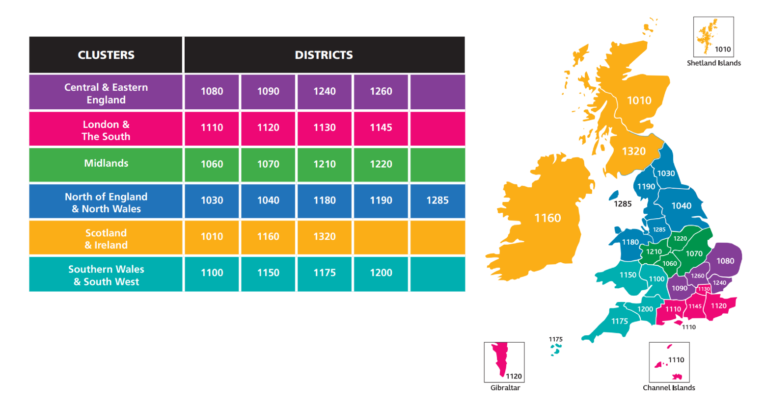
Rotary Great Britain and Ireland
(RGBI)
22 Districts in RGBI
Grouped into clusters.
We are district number 1040 – Yorkshire and North Lincolnshire
The Rotary year runs from 1st July to 30th June

Slide 10
Key Resources
My Rotary https://my.rotary.org
  Loads of detailed information about all aspects of Rotary.
  Access to an online Learning Centre, which covers vocational training opportunities as well as Rotary specific training.
  Brand Centre (brand guidelines, ability to create marketing material to download, stock photos and videos to download, general promotional material ….)
  It is definitely worth spending an hour seeing what My Rotary has to offer.
1040 Knowledge Library https://www.1040knowledge.net
  Designed and maintained by Susan Rogers to keep all information / knowledge in one place
  Is updated periodically

Slide 11
Main different types of club models
Club Model | Description | Appeals to
Traditional | The club experience includes having a meal, hosting a speaker, and practicing traditions that members value. Traditional clubs often have higher dues because of venue and meal costs. | People who want to socialize over a meal while learning about a new topic or an opportunity to serve the community
Passport | A club that allows members to attend other clubs’ meetings frequently if they attend a specified number of home club meetings each year | People who travel frequently or who enjoy trying a variety of club experiences and meeting lots of people
Cause-based | A club whose members are passionate about a specific cause and focus their service efforts on that topic | People who want to connect with others while addressing a particular issue
Interest-based | A club that focuses on a particular interest or hobby | People who want to enjoy Rotary by focusing on a shared interest or activity, such as professional development
Corporate | A club whose members (all or most of them) work for the same employer | Employees of one organization who want to do good in their community
Impact club | A club that meets at least twice monthly for service projects and meets occasionally for social events or fundraisers | People who join Rotary to participate in service but who don’t want to or can’t attend meetings, or those who want a club with lower dues

Slide 12
Different types of membership
Club Rotarian (the majority of Rotarians)
Corporate member (a business or organisation that joins a Rotary club and allows up to four of its employees to become full members of the club)
Direct member (A Rotarian who joins as an individual, rather than through a specific club)
Rotary Community Corps (a non-Rotarian who volunteers to work on community projects with a local Rotary club)
Rotaract(or) (a member of a Rotaract club, that helps young people develop leadership and professional skills, and make a difference in their communities. Traditionally aged 18-30)
Interact (or) (a member of Rotary for young people ages 12 to 18. Mainly within schools)
Rotakids (a Rotary-sponsored program for children aged 7–12 that helps them get involved in the community, make friends, and develop leadership skills)
Honorary member (someone who has been recognised for their service to Rotary / community and for embodying its ideals. Honorary members are given special recognition, but they don't have the same rights and privileges as Rotarians)

Slide 13
District 1040
District Governor (DG) Richard Greenwood
District Governor Elect (DGE) Anne Sutcliffe
District Governor Nominee (DGN) Susan Rogers
Secretary Anne Griffin
Treasurer David Robinson
Foundation Chair Stephen Ellis
Membership Chair Caroline Murie
Public Image Chair Vacant
Hub Coordinator & Direct Membership
Tony Scaife
Learning facilitator Susan Rogers
Community & Vocational Chair Vacant
Peace Fellow Officers Christine Bown
Food Lead Juli Thompson
Youth Chair Pat Taylor
Data Protection Officer Elaine Bowers
Equality & Diversity Officer David Shaw
Health & Safety Officer Malcolm Tagg
Safeguarding Officer Brenda Wood
Mediators Mark Stewart-Clarke
Janet Appleton
Carol Jordan
District 1040 consists of roughly 2000 Rotarians in 90 Rotary Clubs.
There is a District Support Team (DST) headed up by the District Governor.
DST for 2024-25:

Slide 14
District 1040
The District is subdivided into “groups”, each headed up by an Assistant governor (AG), who should keep the District Governor informed of what is happening in that Group, any issues that need addressing, any specific help that is needed etc.
  Adventurers is in the Group called G10, the AG of which is Caroline Murie.
There are a range of centrally organised Youth competitions (Youth Speaks, Young Chef, Young Photographer, Young Artist, Young Writer, Technology Tournament, Youth Under Sail, Young Musician)
“Formal” district meetings:
  3 District Forum meetings a year held in York
  District Assembly – setting out plans for the next year and training workshops for specific roles
  Annual conference – currently held in Scarborough early October

Slide 15
The Rotary Club of Adventurers www.rcadventurers.org
Is a passport club
We offer a new way of "doing" Rotary and are project focussed.
We are a modern and flexible Rotary club open to for adults of all ages and backgrounds to come together to do work locally, nationally and internationally whilst having a lot of fun.
We believe that Rotary should fit around your life and not the other way around.
Meet by zoom keeps costs to a minimum.
Have an active WhatsApp group to discuss and share projects
We are developing innovative and exciting service projects for local communities and beyond.
If members have an idea for a project, the club will support them to get it off the ground.

Slide 16
Appendices

Slide 17
Common Rotary Acronyms. A full list can be found in the Knowledge Library (www.1040knowledge.net)
AG Assistant District Governor)
DG District Governor
DGE District Governor Elect (the next DG)
DGN District Governor Nominee (the next DGE)
DGNE District Governor Nominee Elect (the next but one DGE)
DKL Digital Knowledge Library
DOGS Doers of good service
DOTS District Officer Training Seminar
DRFC District Rotary Foundation Committee
DST District support tea
EREY Every Rotarian Every Year
IPDG Immediate Past District Governor
LDT Leadership development team
MPRC Marketing and Public Relations Committee
PDG Past District Governor
PE President Elect (Club)
PETS President Elect Training Seminar (same as PEPS)
PHF Paul Harris Fellow
Pre‐PETS Preliminary President Elect Training Seminar
RC Rotary Club
RCC Rotary Community Corps
RGBI Rotary Great Britain & Ireland
RI Rotary International
Rtn Rotarian
RYLA Rotary Youth Leadership Award
SAT Specialist Adviser Teams
TRF The Rotary Foundation
YIR Yours in Rotary

